Slide 1

Comparison of Structural and Metabolic Biomarkers of Neurodegeneration for Brain Age Prediction

Slide 2

Nothing to disclose.

Slide 3
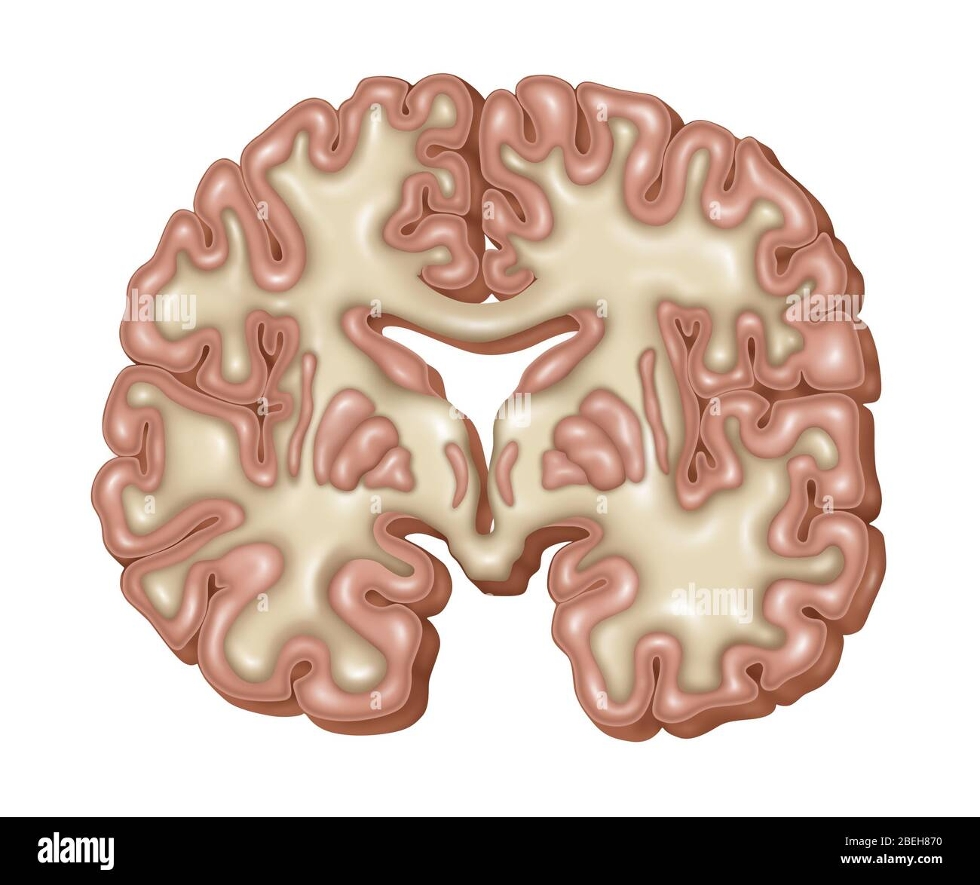
The aging brain undergoes changes at various levels.
With age, incidences of various neurological conditions, such as stroke, white matter lesion and dementia rise. The aging brain undergoes changes at various levels from metabolism to morphology.

Slide 4


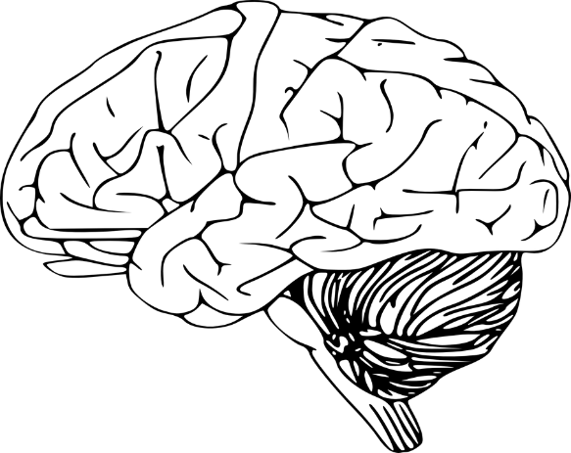

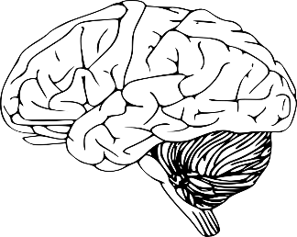
Brain-Predicted Age & BPAD
Brain-predicted age (BPA) = machine learning algorithms learn to predict chronological age (CA) from brain scans
BPAD
The difference between chronological age and brain-predicted age is referred to as Brain-Predicted Age Difference (BPAD).
BPAD is associated with a variety of neurological conditions.
BPAD expresses the deviation from “normal” aging in a single number.
age = 75
CA = 63 BPA = 75
Chronological Age = 63
Brain age Prediction
Brain-Predicted Age Difference = 12 years
Fig. 2. Schematic Illustration of Brain-Predicted Age Difference

Slide 5
Brain Age can have various clinical functions.
assess general brain health
detect disorders before symptom onset
support differential diagnosis

Slide 6
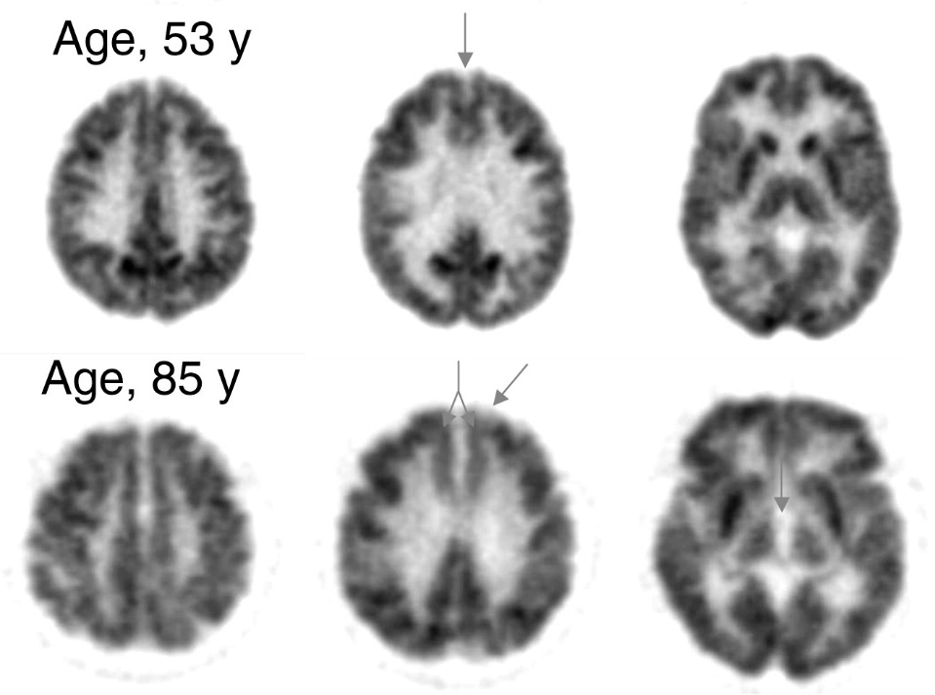
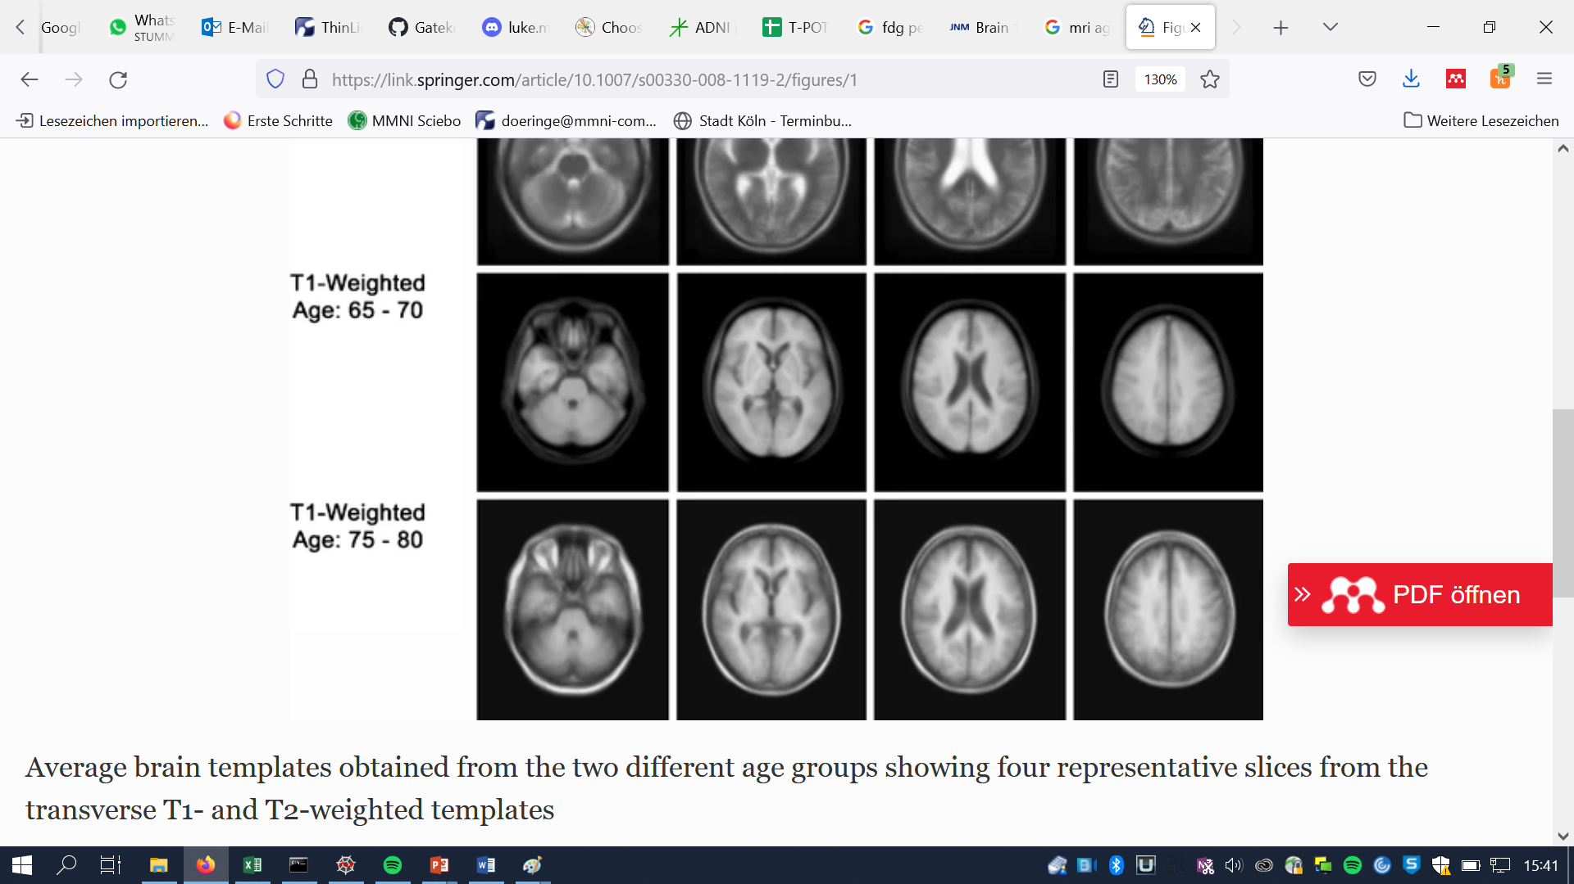
18-F-FDG-PET and MRI are associated with brain aging.
¹⁸F-FDG-PET
^{Structural MRI}
Brain ¹⁸F-FDG-PET is used to visualize metabolic activity in the brain.
Brain MRI provides information on the shape, size and integrity of the brain.
Dukart et al., 2013
Silverman et al., 2004; Farrel et al, 2009
Notes:
FDG-PET displays greater and more consistent changes as compared to structural MRI at early stages of AD

Slide 7
Brain age is almost exclusively predicted with MRI.
Brain FDG-PET and sMRI are strongly associated with aging. Yet, the potential of the two modalities to predict brain age has not been compared. The vast majority of brain age prediction approaches focuses exclusively on MRI.

Slide 8

Research Aims
Compare precision of brain-predicted age using sMRI and FDG-PET in cognitively normal individuals (CN).
Compare association of sMRI and FDG-PET-predicted age with strength of clinical symptoms of dementia in CN and individuals with mild cognitive impairment (MCI).
PET-predicted age
MRI-predicted age
Chronological age
Chronological age
Notes:
SLIDE LOOKS LIKE SHIT

Slide 9

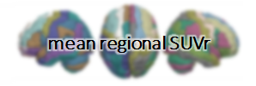

Compare precision of brain-predicted age in CN
379 FDG-PET and sMRI scans from of CN from
Same individuals
Same timepoint (+/- 1 year)
PET
MRI
FL_L FL_R HIP_L HIP_R
Subj_1 1.03 1.25 … 0.95 0.98
Subj_2 1.11 1.08 … 1.02 1.02
… … …
ADNI sample
70 % training data (n = 256)
+
frontal lobe left: 1.03 frontal lobe right: 1.25 … hippocampus left: 0.95 hippocampus right: 0.98
External validation set (n = 59)
30% testing data (n = 123)

Slide 10

Compare precision of brain-predicted age in CN
70 % training data (n = 256)
5-fold cross-validation
Support Vector Regression
Relevance Vector Regression
- Final model: smallest mean absolute error (MAE) across validation folds
Evaluation on independent test sets
30% testing data (n = 123)
External validation set (n = 59)
Notes:
OUTLIER EXCLUSION

Slide 11
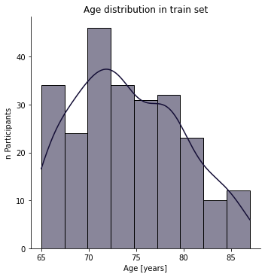
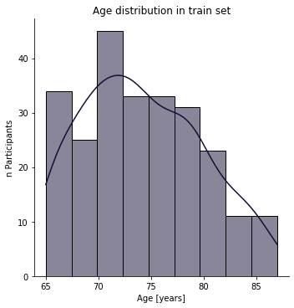
Participants
Training Set
PET MRI

Slide 13
References
Silverman DH. Brain 18F-FDG PET in the diagnosis of neurodegenerative dementias: comparison with perfusion SPECT and with clinical evaluations lacking nuclear imaging. J Nucl Med. 2004 Apr;45(4):594-607. PMID: 15073255.
Farrell, C., Chappell, F., Armitage, P.A. et al. Development and initial testing of normal reference MR images for the brain at ages 65–70 and 75–80 years. Eur Radiol 19, 177–183 (2009). https://doi.org/10.1007/s00330-008-1119-2

